Slide 1

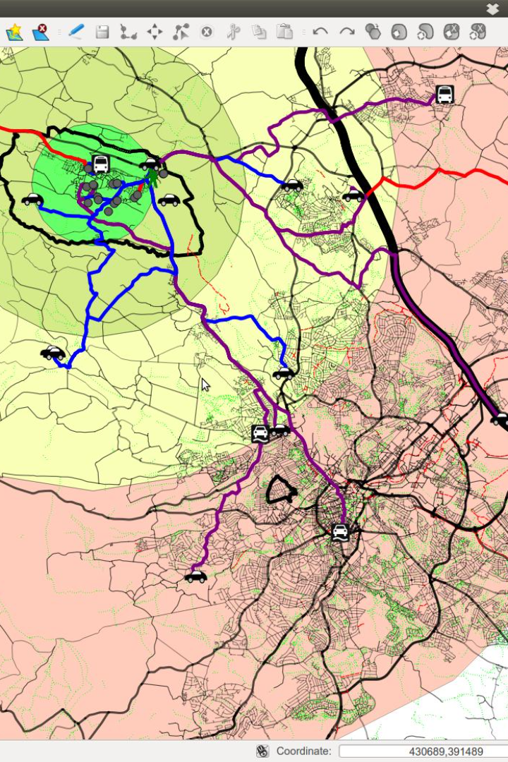

Website Traffic Analysis Project
Website traffic analysis is a crucial process for understanding user behavior, popular pages, and traffic sources. By gaining insights from website traffic data, we can enhance the user experience and optimize our website performance. In this project, we will define analysis objectives, collect website traffic data, utilize IBM Cognos for data visualization, and integrate Python code for advanced analysis.

Slide 2

Design Thinking
1
Analysis Objectives
Define key insights to extract from website traffic data, such as identifying popular pages, traffic trends, and user engagement metrics.
2
Data Collection
Determine the sources and methods for collecting website traffic data, including page views, unique visitors, referral sources, and more.
3
Visualization
Plan how to visualize insights using IBM Cognos to create meaningful dashboards and reports.
4
Python Integration
Consider incorporating machine learning models to predict future traffic trends or user behavior patterns.

Slide 3
FLOW CHART
1
Data Sources
Identify and gather data from various sources, such as website analytics tools, server logs, or third-party platforms.
Data Cleaning
2
Ensure data accuracy and relevance by removing duplicates, correcting errors, and standardizing formats.
3
Data Transformation
Convert data into a unified format for seamless integration into analytical tools and platforms.
Data visualization
4
The converted data from the given tools is propely aligned and visualized.

Slide 4
Data Collection
Efficient data collection is vital for obtaining accurate insights from website traffic. We will gather information on various aspects, including:
Page Views
Unique Visitors
Track the number of times each page on the website is viewed.
Identify the number of individual users visiting the website.
Referral Sources
Click-Through Rates
Analyze the channels through which users are directed to the website, such as social media, search engines, or other websites.
Evaluate the percentage of users clicking on specific links or advertisements.

Slide 5
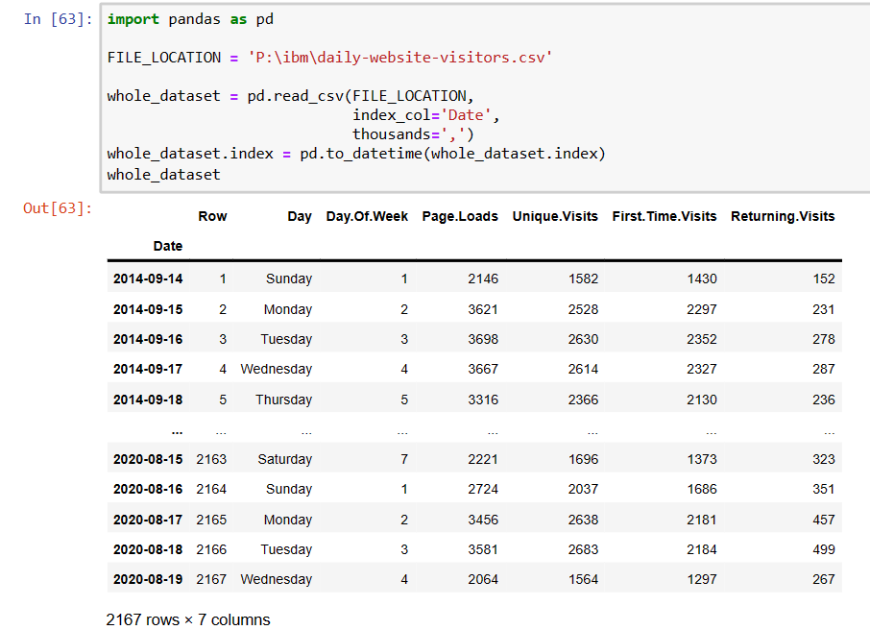
Collection source
In order to analyze website traffic, we need to identify trustworthy sources and methods for collecting transportation data. These sources could include schedules, real-time updates, and website visitors.

Slide 6
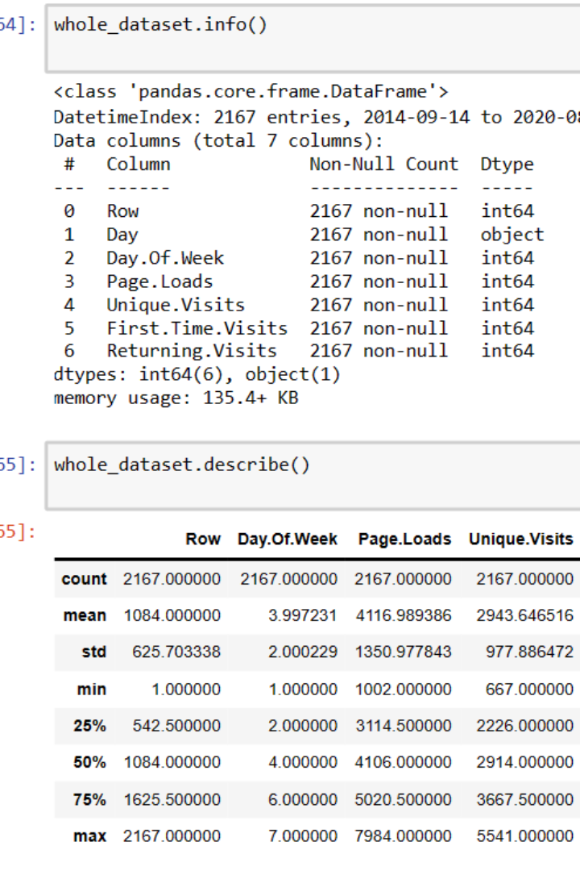
Data Cleaning
Data cleaning, also known as data cleansing or data scrubbing, is a crucial process in data management and analysis. It involves identifying and correcting or removing errors, inconsistencies, and inaccuracies in datasets to ensure that the data is accurate, reliable, and suitable for analysis or other purposes.
Website visitors data has been cleaned to normal analyzed view for better understanding.

Slide 7
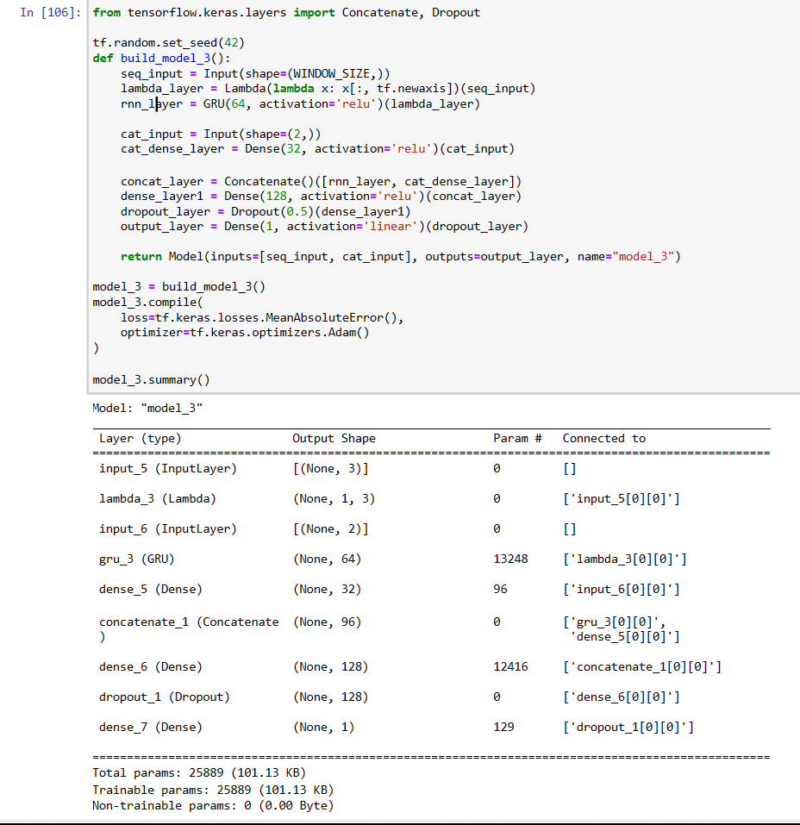
Data Transformation
Website traffic analysis involves the collection and examination of data related to visitor interactions on a website. Raw data collected from website analytics tools can be extensive and unstructured. Data transformation is a crucial step in the process of turning this raw data into actionable insights.

Slide 8
Data Visualization
Data visualization is an essential component of the website traffic analysis project. Through visually appealing and intuitive dashboards, we can effectively communicate insights. Key considerations for data visualization include:
Clear and Concise
Interactive Features
Effective Use of Charts
Present information in a straightforward and digestible manner, ensuring the main insights are easily understandable.
Enable users to explore data interactively, allowing for customized views and drill-down capabilities.
Select appropriate chart types, such as line graphs, bar charts, and pie charts, to represent different aspects of website traffic data.

Slide 9
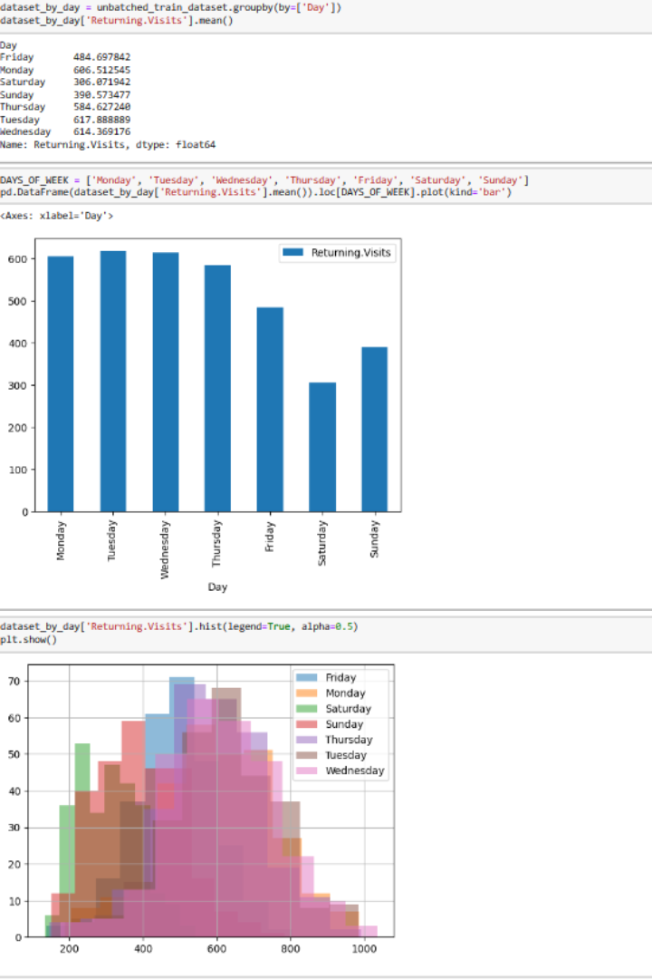
VISUALIZATION
This format represent the days of the website invocation and the datas that concerns the Returning sites in the base of the dates or days.Effective visualization is a crucial component of website traffic analysis. It helps transform complex data into meaningful and actionable insights.

Slide 10
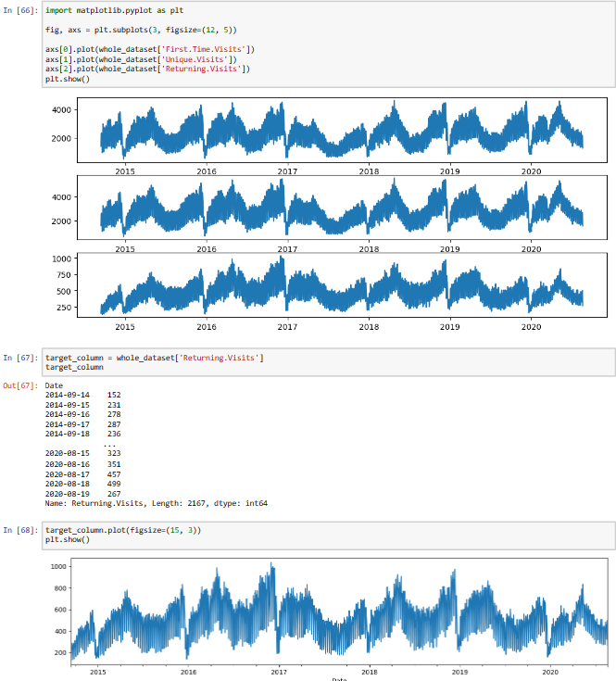
STRATEGY
The plots are generated through the number of years and amount of the website visitors in a website of First visit,Unique visit,Returning visit.Developing an effective visualization strategy for website traffic analysis is crucial to derive actionable insights and communicate findings clearly to stakeholders.

Slide 11
Python Integration
1
Machine Learning Models
Leverage Python to develop machine learning models that can predict future traffic trends and user behavior patterns.
2
Advanced Analysis
Use Python code to perform advanced analysis on the website traffic data, extracting deeper insights beyond standard metrics.
3
Integration with IBM Cognos
Integrate Python code seamlessly with IBM Cognos for a comprehensive analysis that combines statistical models with visualizationW

Slide 12

Conclusion
The website traffic analysis project provides invaluable insights into user behavior, popular pages, and traffic sources. By leveraging data collection, integration, visualization, and Python integration, we can optimize our website's performance and enhance the user experience. Through clear and concise dashboards, we empower decision-makers with the information necessary to make data-driven decisions and drive organizational success.

